Slide 1



Verifying Bit-vector Invertibility Conditions in Coq
Burak Ekici, Arjun Viswanathan, Yoni Zohar, Clark Barrett, Cesare Tinelli

Slide 2

Introduction
Bit-vectors are useful for many verification tasks
Many applications require reasoning about quantified bit-vectors
SMT solvers deal with quantified formulas using quantifier-instantiation techniques
CVC4 uses invertibility conditions as part of a quantifier instantiation technique for bit-vectors
Notes:
Applications of bit-vectors: bounded model checking [Armando et al., 2006] and circuit analysis [Gupta et al., 1993]

Slide 3
Previous Work Contributions
Niemetz et al. [CAV 2018] generated 162 invertibility equivalences and verified them automatically for bit-widths up to 65
Niemetz et al. [CADE 2019] encoded these equivalences in QF(NIA+UF) to verify 75% of the equivalences for arbitrary bit-width
We proved 11 equivalences from the rest of the 25% of the equivalences in the Coq proof assistant for arbitrary bit-width
We used a Coq library originally used for SMTCoq developed by Ekici et al. [CAV 2017] and extended its signature

Slide 5


Invertibility Conditions
An invertibility condition for a variable x in a bit-vector literal
is a formula
s.t. the following invertibility equivalence is valid in the theory of bit-vectors:

Slide 6
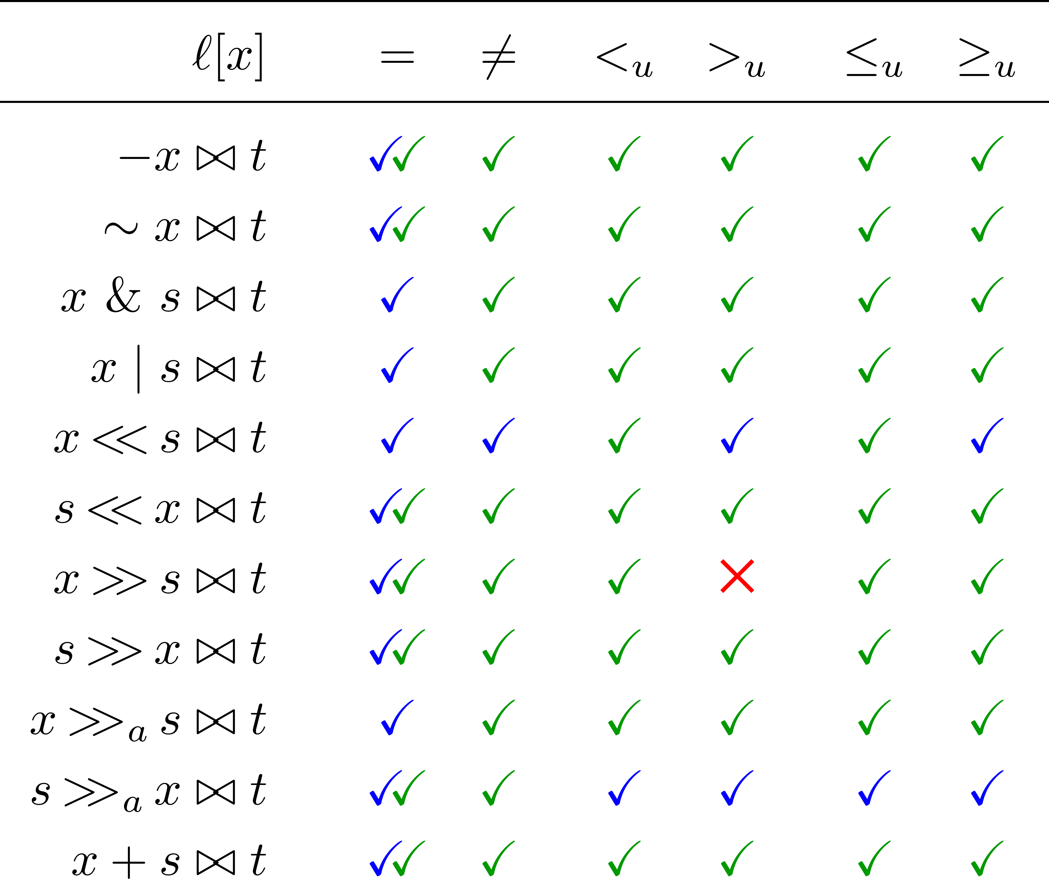
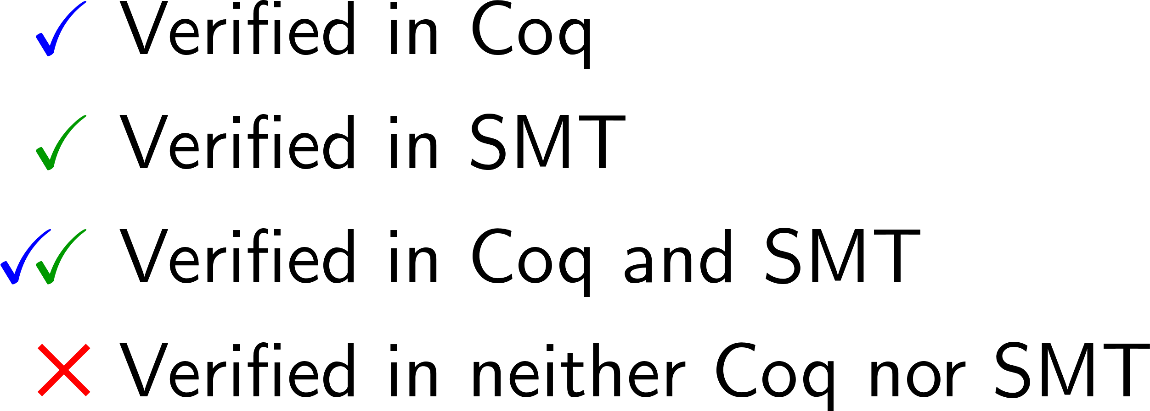
Result Summary

Slide 7
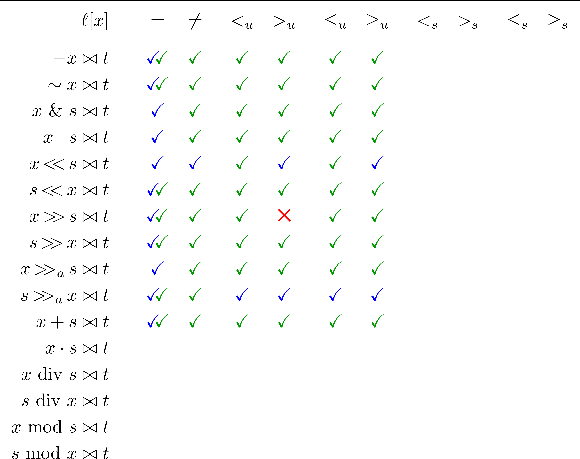
Future Work
… …
… …
… …
… … …
… … …

